Slide 1
Capstone Project: The Battles of Neighborhoods
Jia Wang
June 2019

Slide 2
Table of Content
1. Introduction
1.1 Background
1.2 Specific problems to solve
1.3 Interested audiences
2. Data
3. Methodology
3.1 Import rental information and clean data
3.2 Crime rate data scraping
3.3 Explore the restaurant venues nearby
4. Results
5. Discussion and Conclusion

Slide 3



---Background
Introduction
1
Nowadays, due to various reasons, people tend to move from one city to another, or even from one country to another.
Other reasons…

Slide 4

Introduction
---Background
1
However, sometimes people are not quite familiar with the new country or city that they are going to move to. So they will have problems in choosing where to live. This is a difficult and time-consuming decision to make.
Where to live?

Slide 5
Introduction
---Background
1
Multiple factors need to be considered while deciding where to live in a new city/country, such as distance from work, monthly rent, safety, nearby restaurants and so on…
Where to live
Distance from work
Monthly rent
Safety
Nearby restaurants
…

Slide 6
Introduction
---Background
1
So in order to help people make wiser choice according to their needs, relevant information need to be gathered and analyzed.
Name | Address | Zip code | Rent | Distance from work | Crime rate | Food venues | …
… | … | … | … | … | … | … | …
… | … | … | … | … | … | … | …
… | … | … | … | … | … | … | …

Slide 7

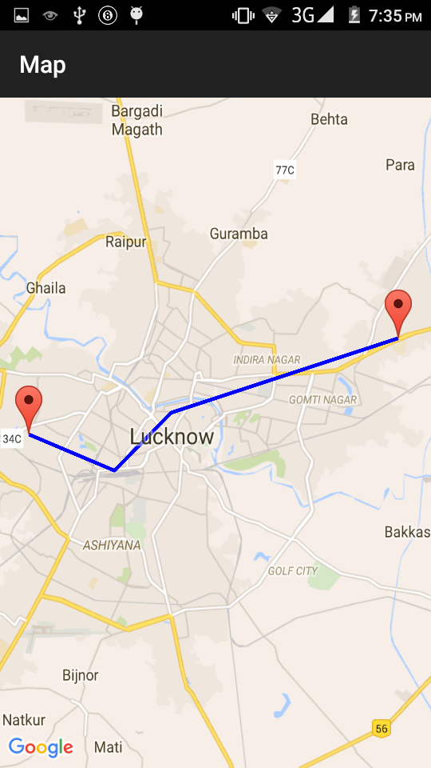


Introduction
---Specific problems to solve
1
In my case, I would like to find a suitable place to live in New York City. There are several requirements that I hope the potential rental place can meet.
1. The monthly rent won’t be higher than US $2000.
2. The distance between New York University (70 Washington Square South New York, NY) and the rental place is within 3 miles.
3. Safety is a critical issue, so I prefer those with lower crime rates.
4. I prefer Asian food, especially Chinese and Japanese food, it will be great if there are good-rating Chinese and Japanese food restaurants nearby.

Slide 8

Introduction
---Interested audiences
1
Although this is a specific case study, general methodology and analysis are applicable to all other cases. Depending on the requirements of different people in different city or country, anyone who would like to get customized suggestions in choosing place to rent will find it be to be useful.

Slide 9
Data
2
We will need the following data for this project:
Information containing name, address, type, and monthly rent for potential places for rent.
Criteria: near New York University, with US $2000 as maximum monthly rent.
Criteria: restrict in New York City.
Output: add coordination information into rent_data_mining.
Crime rates (violent and property) of places for rent.
Criteria: none
Source: https://www.bestplaces.net/crime/zip-code/new_york/new_York, using the zip code of places after filtering according to distance.
Source: https://www.rent.com/new-york/new-york-university- houses/max-price-2000
Output: rent_data_mining.csv
Source: using foursquare agent and get coordination information for places in rent_data_mining.csv,
Usage: for later process.
Usage: to calculate the distance between New York University and place for rent, then filter according to requirements.
Output: add both violent and property crime rates for filtered places.
Usage: for later process.
Restaurants venues, category and rating for candidate places.
Coordination information of places for rent.
Criteria: query is restricted to restaurants, focus on Chinese and Japanese food, rating must be higher than 7.
Source: using foursquare API and places after filtering.
Output: add coordination information into rent_data_mining.
Usage: determine whether these places have qualified restaurants and go back to check the crime rates for those places who meet the requirements.

Slide 10
Methodology
3
This section will mainly cover the process of how the data is gathered and filtered for analysis.
Data will be filtered and analyzed based on following requirement: monthly rent, distance from New York University, crime rate and restaurants nearby.
The maps with popup labels allow quick identification of location, thus making the selection more straightforward.

Slide 11
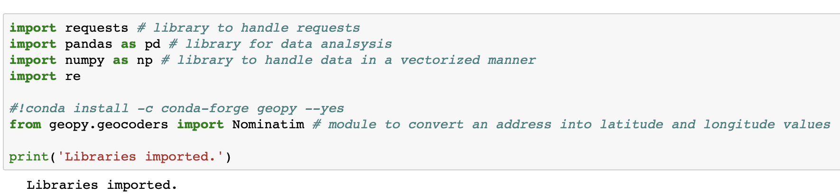
Methodology
3
First import general libraries.

Slide 12
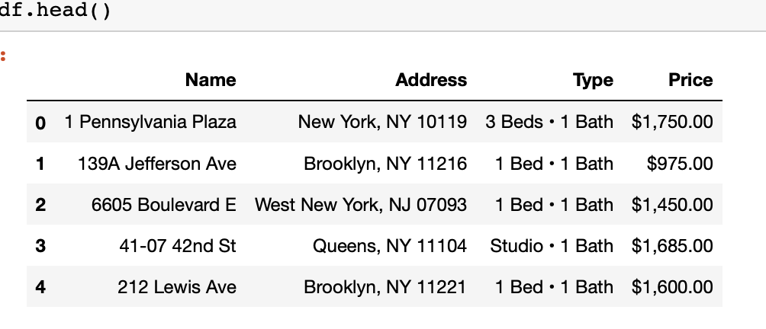
Methodology
---Import rental information and clean data
3
Import rent_data_mining.csv into dataframe.

Slide 13
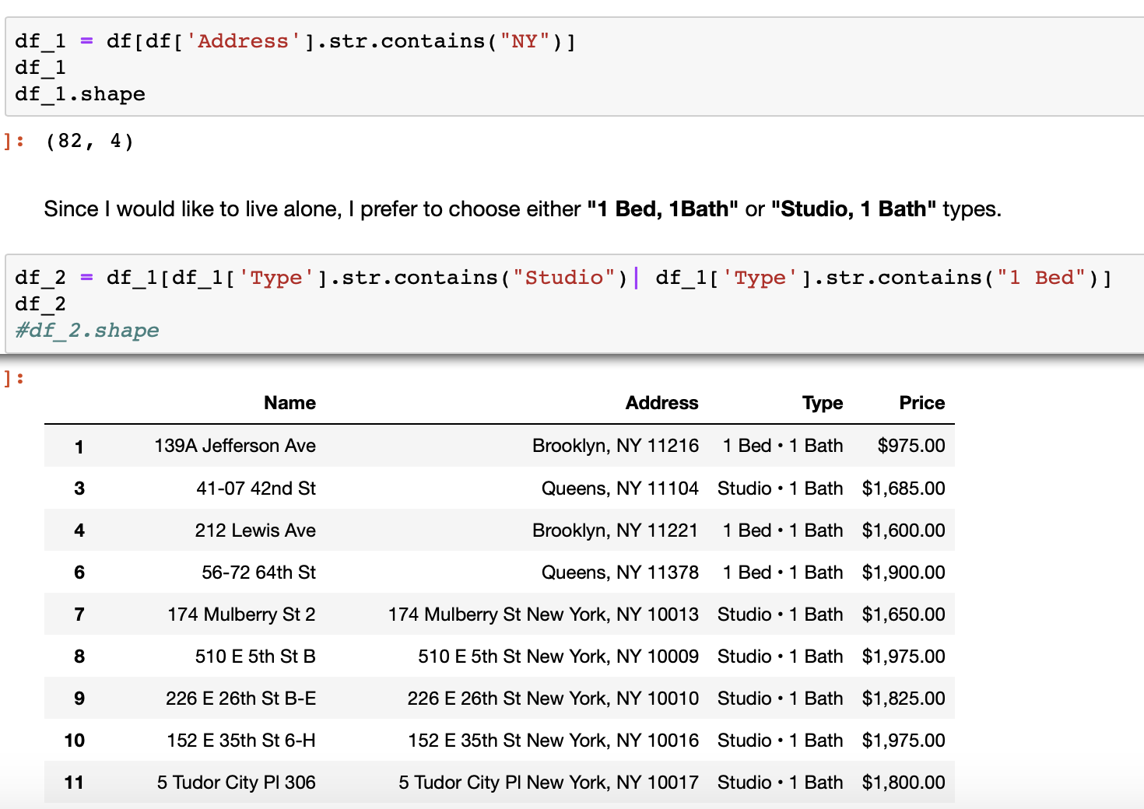
Methodology
---Import rental information and clean data
3
Let’s simply focus on New York City, and either studio, 1 bath or 1 bed, 1 bath type.

Slide 14
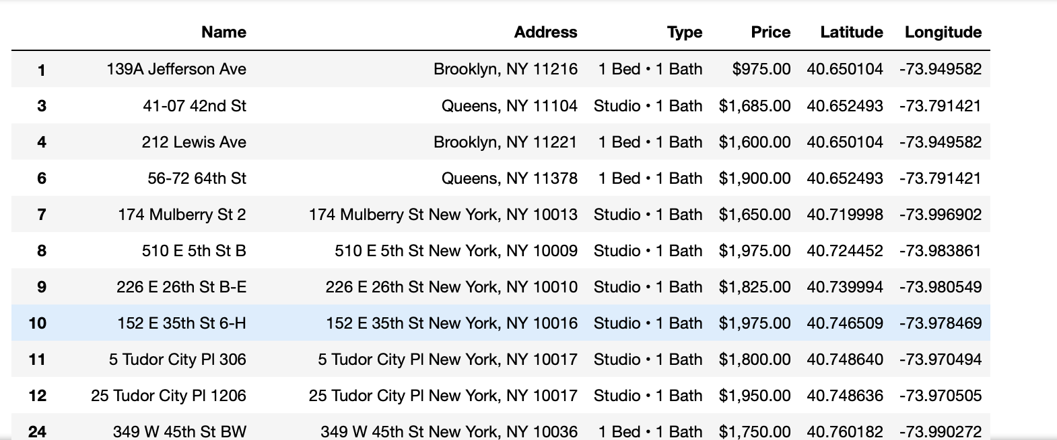
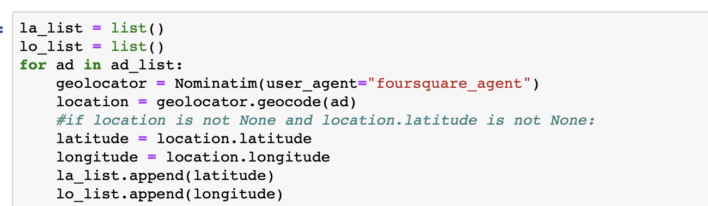
Methodology
---Import rental information and clean data
3
In order to filter places based on distance from New York University, let’s get the coordination of each place first using the address information and foursquare agent.

Slide 15
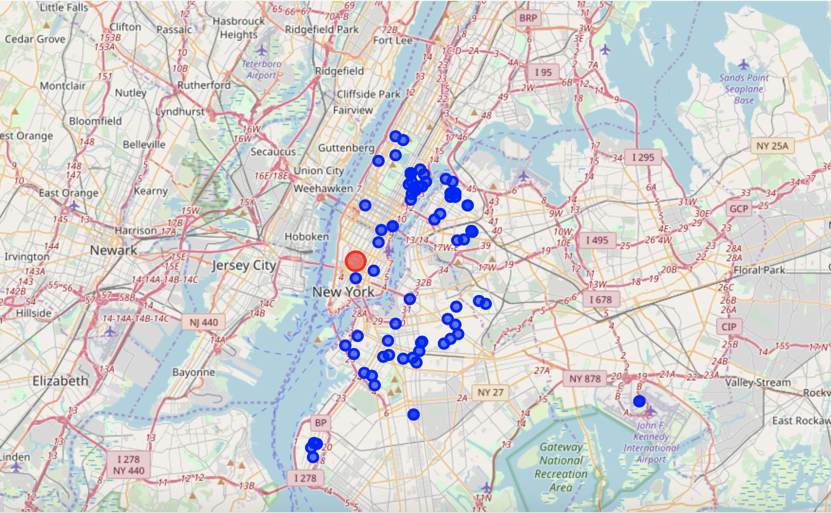
Methodology
---Import rental information and clean data
3
Let’s visualize their locations on the map.
Red: New York University
Blue: candidate places for rent

Slide 16
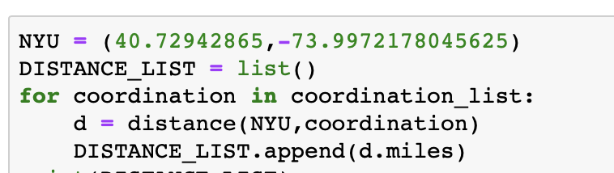
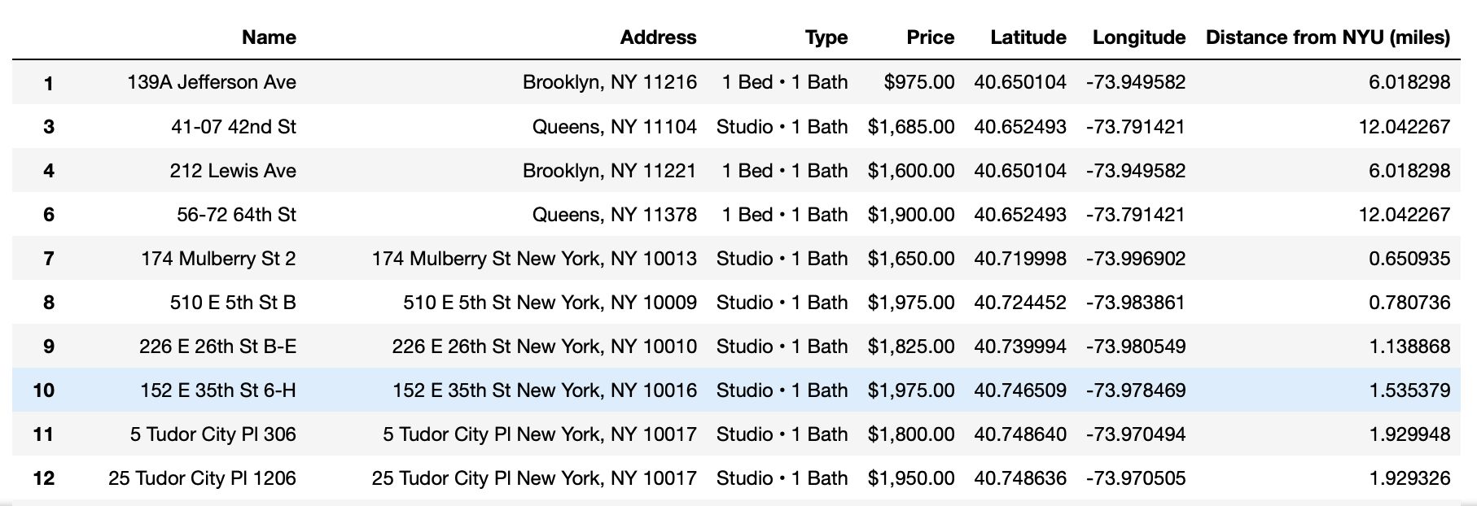
Methodology
---Import rental information and clean data
3
From geopy.distance library, import distance. Use the coordination of candidate places and New York University to calculate the distance.

Slide 17
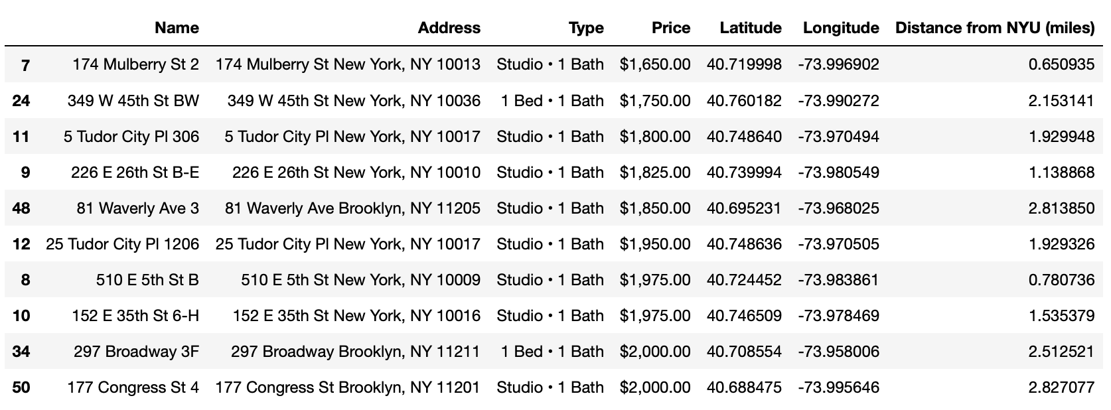
Methodology
---Import rental information and clean data
3
Filter and drop those whose distance is greater than 3 miles from New York University.

Slide 18
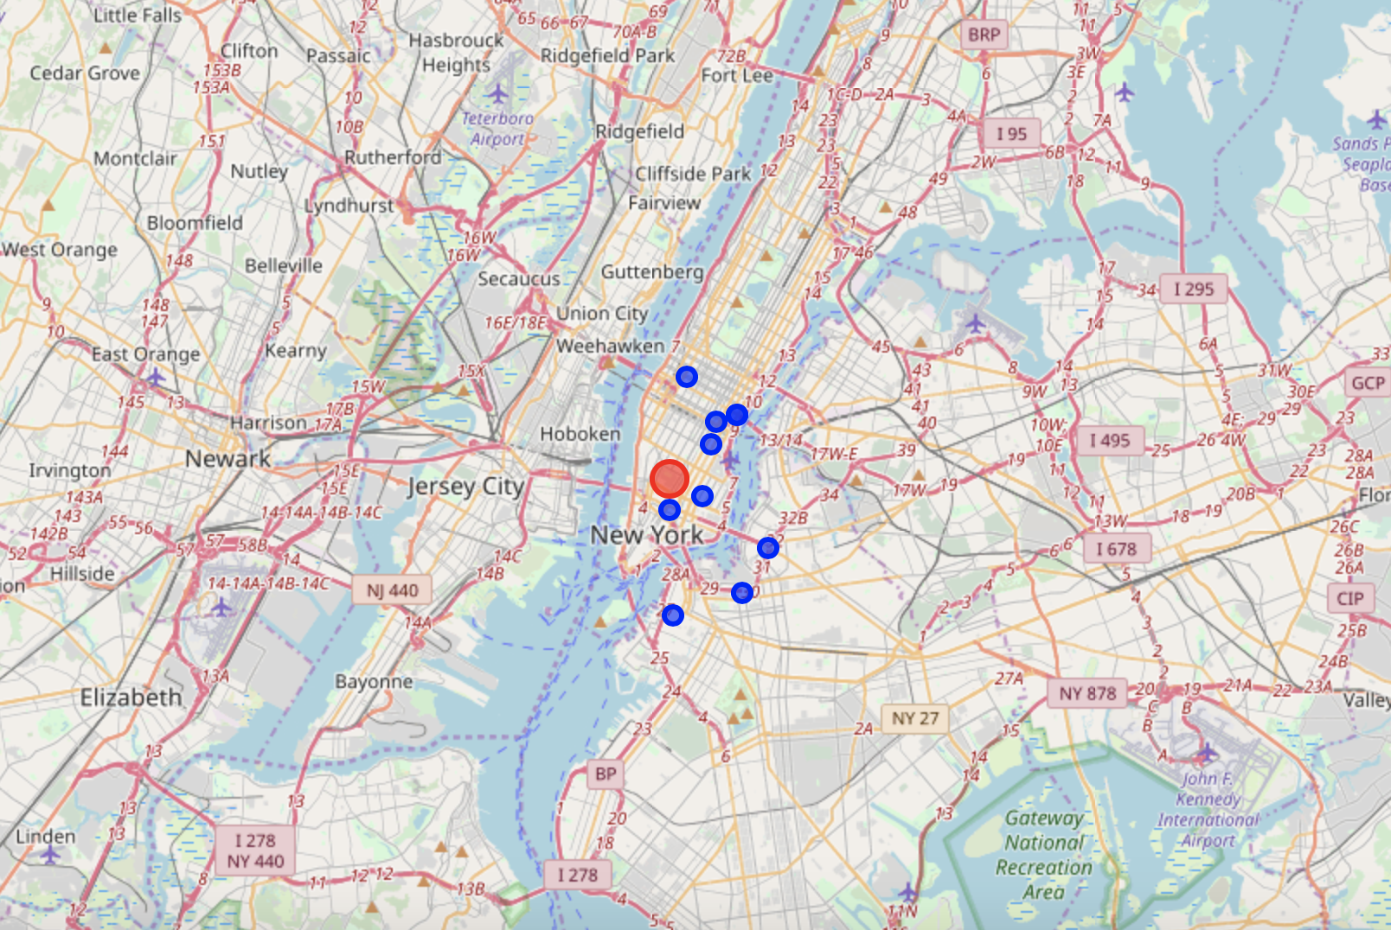
Methodology
---Import rental information and clean data
3
Let’s visualize the locations of filtered places locations on the map.
Red: New York University
Blue: candidate places for rent

Slide 19
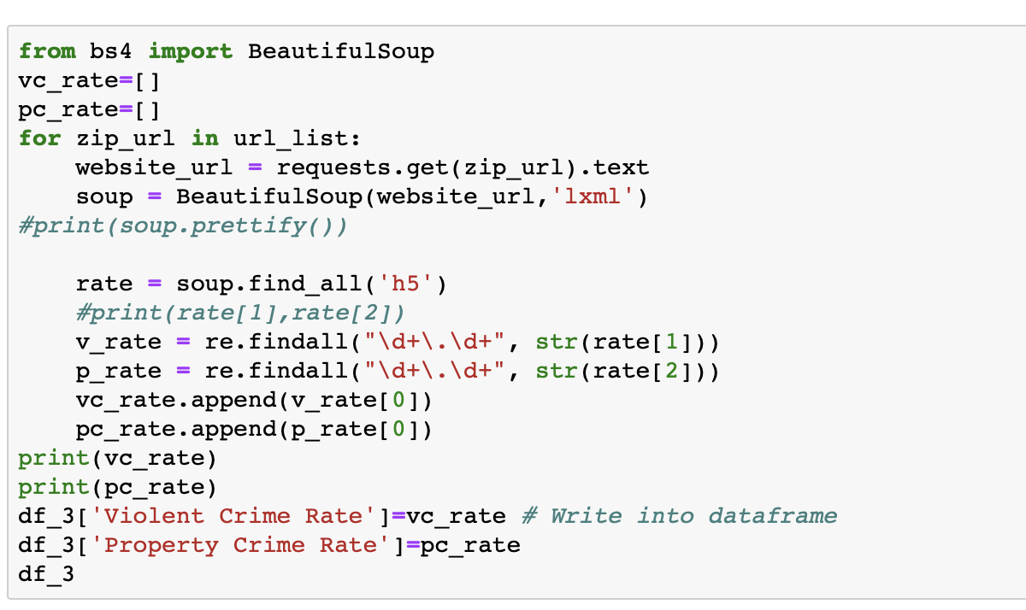
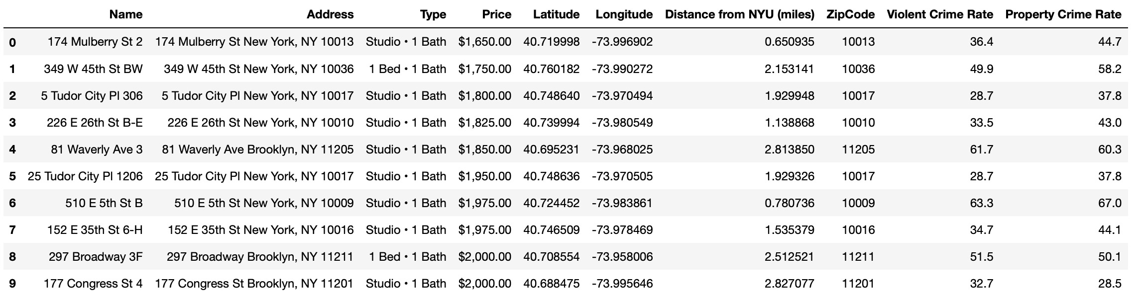
Methodology
--- Crime rate data scraping
3
To get the violent crime rate and property crime rate for filtered places, I will use the following website https://www.bestplaces.net/crime/zip-code/new_york/new_york/11210 and zip code of those rental places to scrape the crime rates. To do so, I choose to use beautifulsoup4.

Slide 20
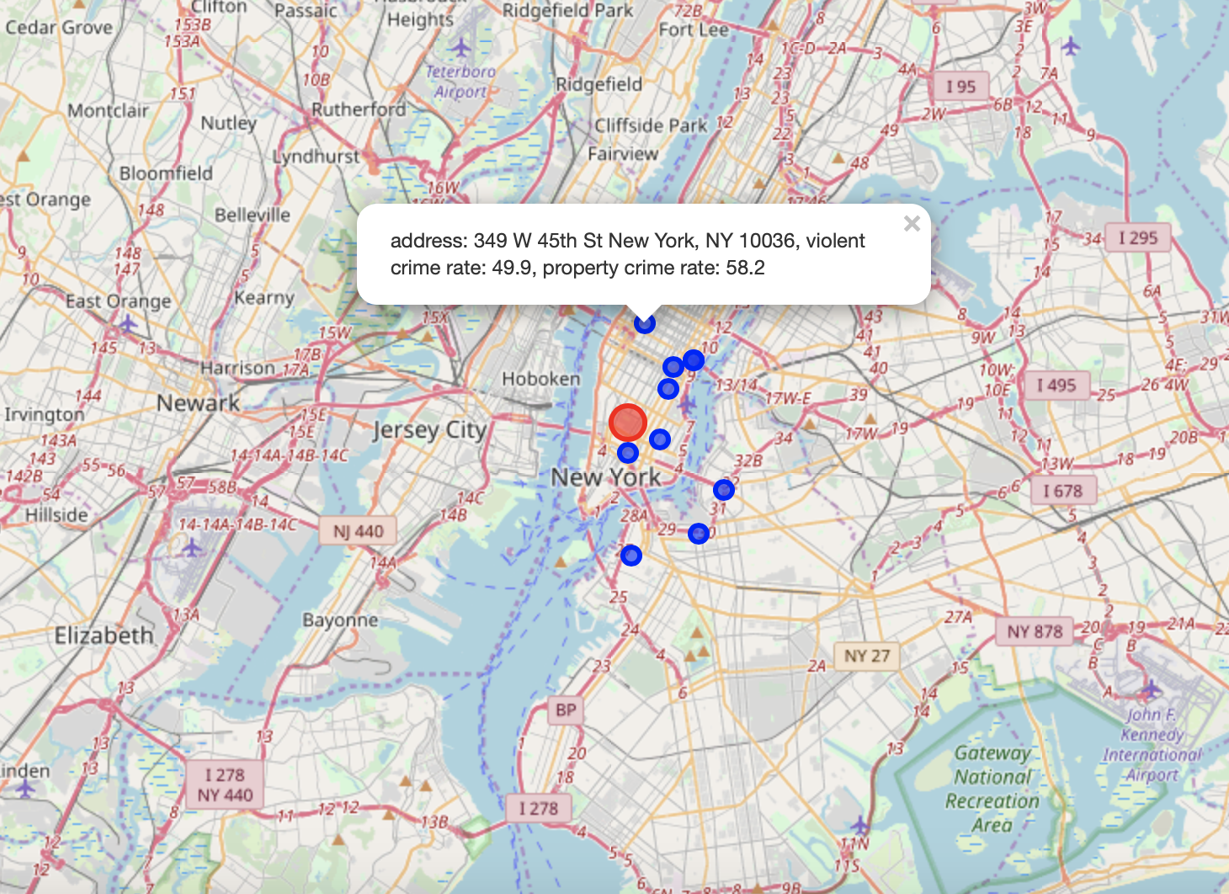
Methodology
--- Crime rate data scraping
3
Visualize both places and crime rates on the map.
Red: New York University
Blue: candidate places for rent

Slide 21
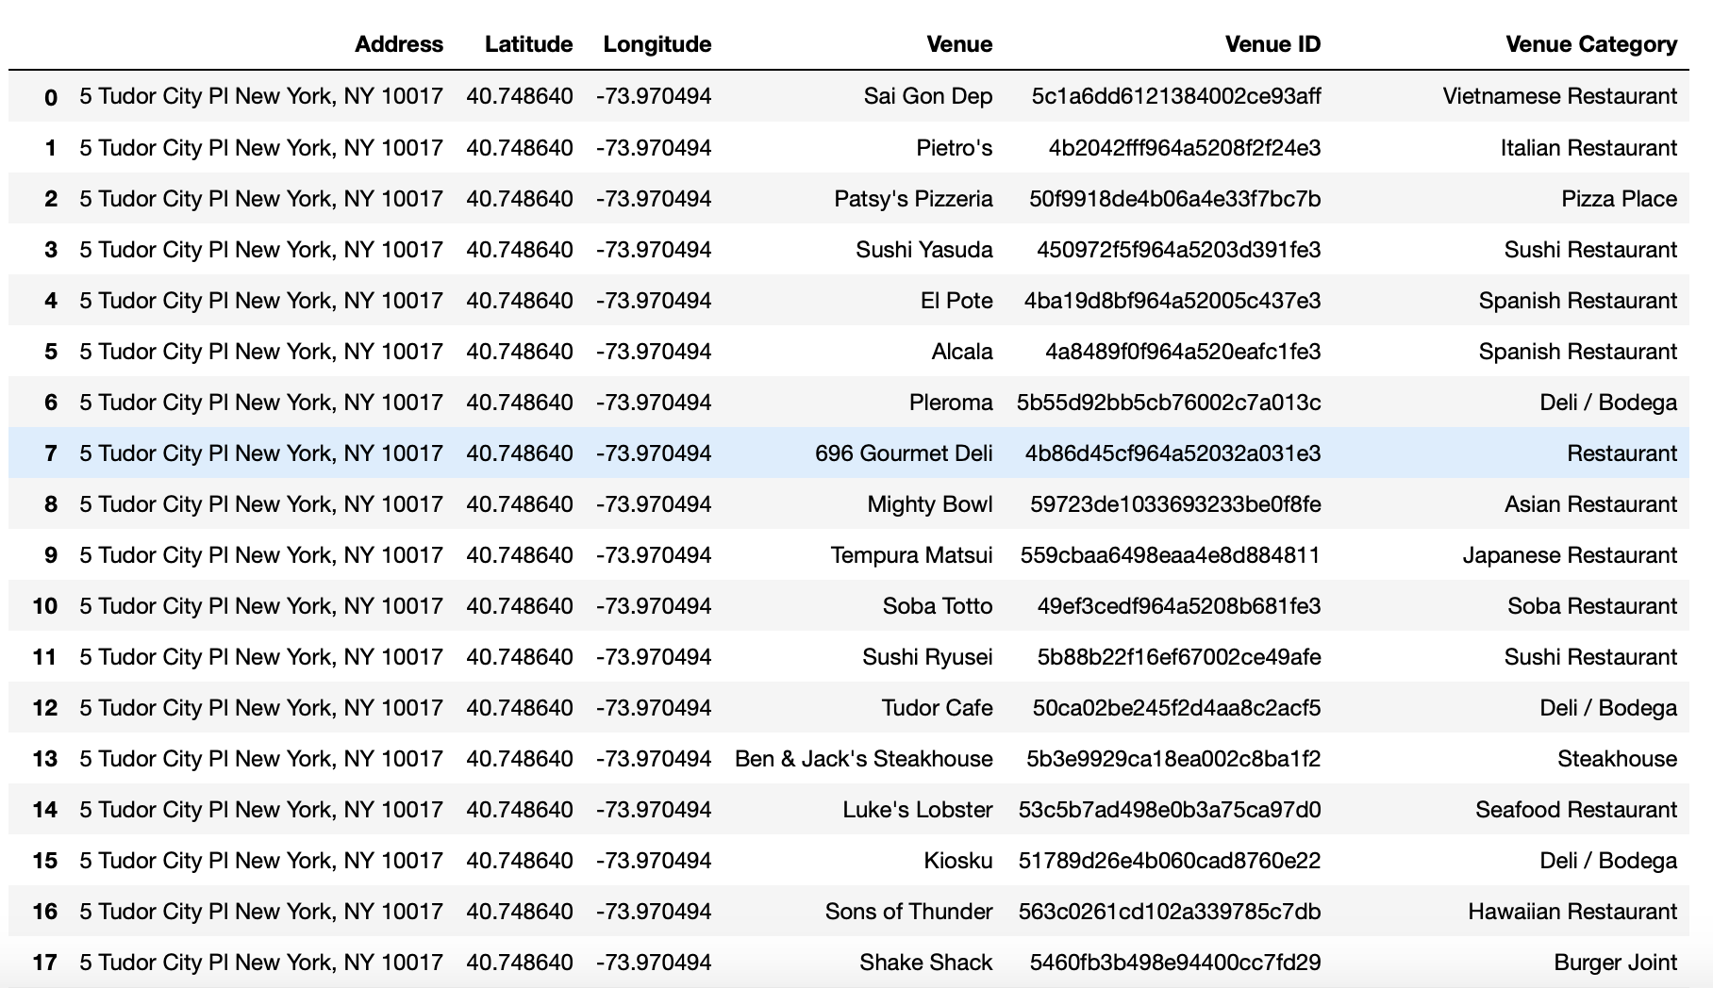
Methodology
--- Explore the restaurant venues nearby
3
Use foursquare API to get venue information for filtered places. (Note: the query was set to be restaurants, so only restaurant venues will appear in the results.)

Slide 22
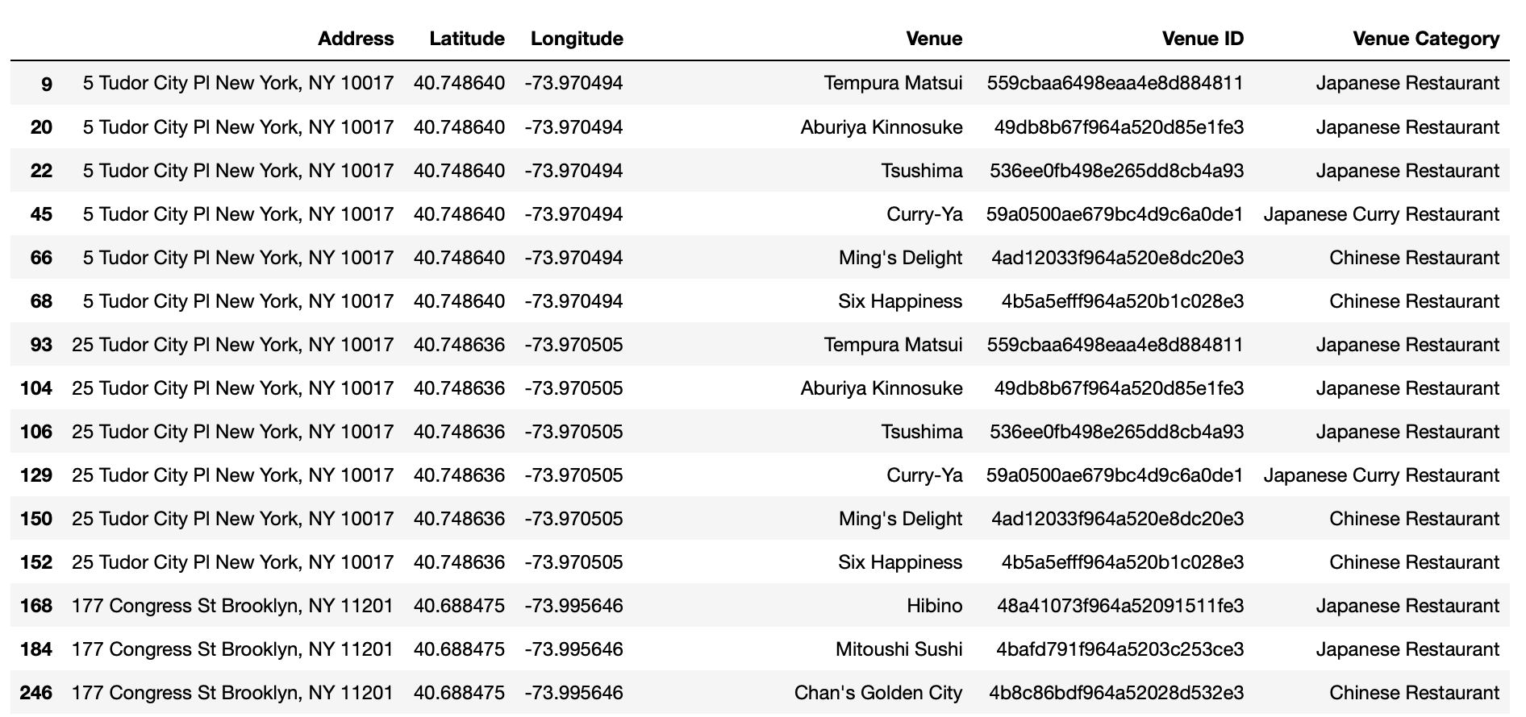
Methodology
--- Explore the restaurant venues nearby
3
Filter out those venue category belongs to either Chinese or Japanese food.

Slide 23
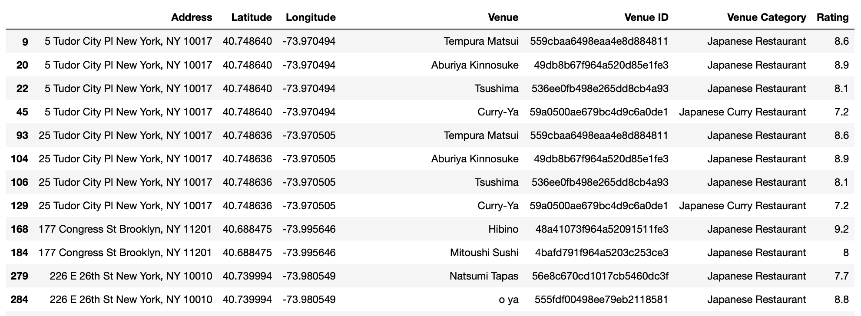
Methodology
--- Explore the restaurant venues nearby
3
To get the rating of each restaurant, I have to explore each venue. https://api.foursquare.com/v2/venues/VENUE_ID?client_id=CLIENT_ID&client_secret=CLIENT_SECRET&v=VERSION
Drop those venues without rating or rating less than 7.

Slide 24
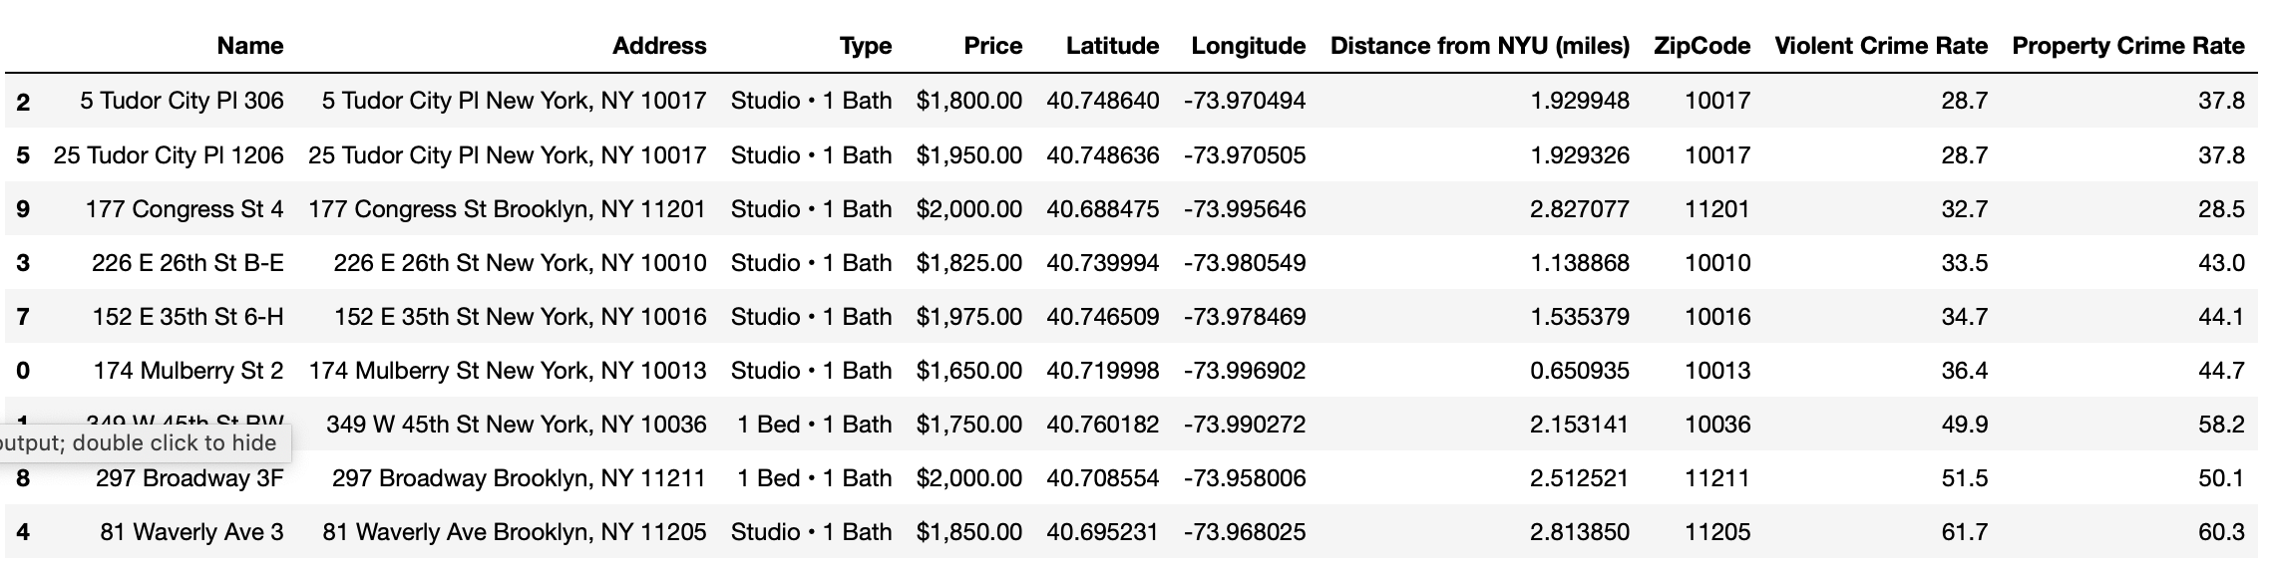
Methodology
--- Explore the restaurant venues nearby
3
Filter out the places who have qualified restaurants nearby, and check the crime rates for those places.
"5 Tudor City PI 306" and "25 Tudo City PI 1206" have lower crime rates than others.

Slide 25
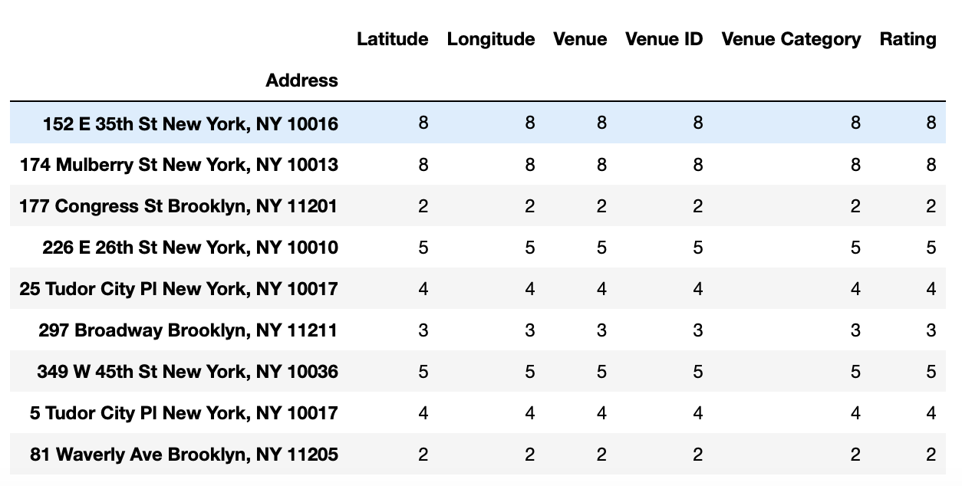
Results
3
Based on above data mining, cleaning and filtering, "5 Tudor City PI 306" and "25 Tudo City PI 1206" are optimal choices that I can select from.
They both meet the requirements that I set: monthly rent less than US $2000, distance from New York University is within 3 miles, relatively low crime rates, have good-rating Chinese or Japanese restaurants nearby.

Slide 26
Discussion and Conclusion
3
In this project, I would like to find a place to rent near New York University. I set requirements for the monthly rent, type of rental place, distance from New York University, relatively safe environment (lower crime rates) and good-rating Chinese or Japanese food restaurants nearby. Eventually, I narrowed down my choice to two places: "5 Tudor City PI 306" and "25 Tudo City PI 1206". By using these data and analysis, I could find those places that meet my preferences. It will also be useful for others who will move to a new city to start a new job, because most of the analysis methods are applicable to other cases, what they need to do is just to change to their requirements.

